Slide 1
HSTA-Retired
Questionnaire Results
2025

Slide 2
Background
HSTA-Retired has had a trend of static membership growth
HSTA-Retired is moving toward membership decline
HSTA-Retired has had difficulty getting members to serve in leadership positions and on committees
What shall we focus on?

Slide 3
HSTA-Retired Leadership decided to survey our members.
HSTA-Retired Executive Committee and Membership Committee, along with NEA-Retired VP Jean Dobashi, developed a questionnaire.
Survey was sent out via email on March 24 through March 31
This data is to be used to inform the leadership on our work over the next year in addressing our membership decline and leadership development

Slide 4
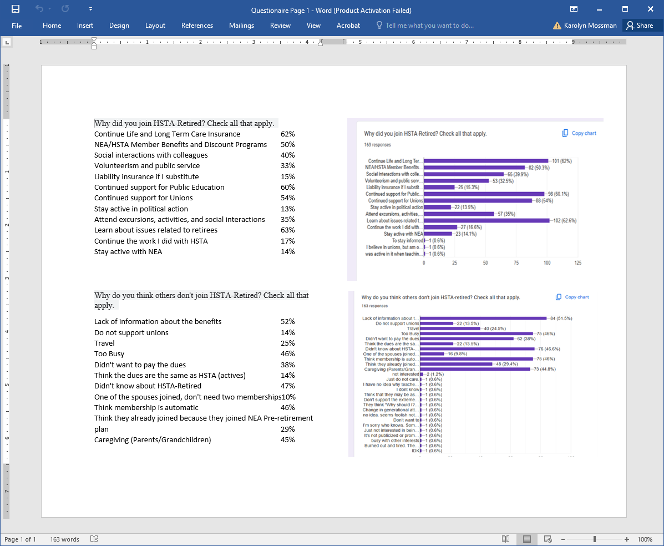

Slide 5
Why did you join HSTA-Retired?
Continue Life and Long Term Care Insurance 62%
NEA/HSTA Member Benefits and Discount Programs 50%
Social interactions with colleagues 40%
Volunteerism and public service 33%
Liability insurance if I substitute 15%
Continued support for Public Education 60%
Continued support for Unions 54%
Stay active in political action 13%
Attend excursions, activities, and social interactions 35%
Learn about issues related to retirees 63%
Continue the work I did with HSTA 17%
Stay active with NEA 14%

Slide 6
Why do you think others don't join HSTA-Retired?
Lack of information about the benefits 52%
Do not support unions 14%
Travel 25%
Too Busy 46%
Didn't want to pay the dues 38%
Think the dues are the same as HSTA (actives) 14%
Didn't know about HSTA-Retired 47%
One of the spouses joined, don't need two memberships 10%
Think membership is automatic 46%
Think they already joined because they joined NEA Pre-retirement plan 29%
Caregiving (Parents/Grandchildren) 45%

Slide 7
Rank the following HSTA-Retired purposes from the most important (1) to the least important (4) to you.
1. Protect the retirement and health benefits of its members; #1
2. Promote the social, professional, economic status, and general welfare of retired members; #2
3. Support united action with others who are devoted to the cause of public education and/ or unionism; #4
4. Initiate and/or support legislative action that is beneficial to retirees #3

Slide 8
The fifth purpose addresses the legal, procedural, ethical requirements. They undergird our work on the other four.
# 5. Operate exclusively as a social welfare organization or local association of employees, within the meaning of Section 501(c)(4) of the Internal Revenue Code of 1986, as amended (or the corresponding provision of any future United States internal revenue law). From the Articles of Incorporation of Hawaii State Teachers
This requires HSTA Retired to follow all the Non-profit laws, labor election laws, and the bylaws of NEA, HSTA, and HSTA-Retired.
However, because we do not bargain for workers as a retired organization, we are not a union, although we are affiliate with HSTA, which is a union.
Did you know this about HSTA-Retired?
No 49.7%
Yes 48.5%
Most of these
I thought I was protected by union
Had to keep researching

Slide 9
What would you be willing to do to assist us in accomplishing our first purpose; protect the retirement and health benefits of its members?

Slide 10
What would you be willing to do to assist us in accomplishing our second purpose; promote the social, professional, economic status, and general welfare of retired members?

Slide 11
What would you be willing to do to assist us in accomplishing our third purpose; support united action with others who are devoted to the cause of public education and/or unionism?

Slide 12
What would you be willing to do to assist us in accomplishing our fourth purpose; initiate and/or support legislative action that is beneficial to retirees?

Slide 13
Our membership numbers are starting to decline.
If we need more money to complete our purposes what is the best way to achieve this?

Slide 14
What would get more membership involvement?

Slide 15
HSTA-Retired's work consists of the following activities: Very/Somewhat 163
Monitor EUTF 146/16
Monitor ERS 139/20
Provide testimony for legislature 79/71
Lobby the legislature for benefits retention and enhancements/related to Kupuna general welfare 117/41
Produce/deliver a statewide newsletter 40/78
Representation on the HSTA Board of Directors 68/69
Provide Pre-retirement workshops on Institute Day 90/58
Assist HSTA in lobbying on public education and union issues 56/70
Elect delegates to the NEA Representative Assembly and the NEA-Retired Annual Meeting 39/78
Provide members information on Members Benefits 120/30
Recruit new members 108/46
Representation on many HSTA Standing Committees 44/66

Slide 16
HSTA-Retired's work consists of the following activities. (Continued)
Affiliation with HARA (Hawaii Association of Retired Americans) 37/70
Train District Officers 56/74
Representation on many HSTA Standing Committees 44/66
Hold elections for state and district officers 56/69
Produce and deliver district newsletters 41/78
Provide resources for districts to have activities, excursions, informational meetings, luncheons, etc. 53/63
Hold General Membership meetings at the district level 57/58
Hold a delegate Assembly for member input and direction 50/62
Produce and distribute a members calendar 51/38

Slide 17
If HSTA- Retired didn't exist who would do this work?
No One | 40
Not Sure/Don’t know | 33
HSTA/NEA | 18
AARP/HARA/Other Kupuna Orgs | 3
HEA | 1
Committed Individuals | 4

Slide 18
If HSTA- Retired closed its doors would anyone notice?
Yes 66
No 15
Don't know 15

Slide 22
Membership Committee: Kim Springer (Chair), Stephen Fong
Executive Committee: Jonathan Gillentine, Valerie DeCorte, Kim Springer, Joan Parker, Karolyn Mossman
NEA-Retired Vice President: Jean Dobashi
Mahalo
Membership Committee Chair: Kim Springer
Committee Members: Stephen Fong
Executive Committee Members: Jonathan Gillentine, Valerie DeCorte, Kim Springer,
Joan Parker, Karolyn Mossman
Mahalo

